Slide 1
CSE 2102: Introduction to Software Engineering
Introduction and Motivation

Slide 2
What is a program ?
A plan or a routine for solving a problem on a computer.
A sequence of instructions used by a computer to do a particular
job or to solve a given problem.
A set of statements or instructions to be used directly or indirectly
in a computer in order to bring about a certain result.

Slide 3
Program as an interface
P
R
0
G
R
A
M
Problem
Domain
Solution
Domain
Program serves as the interface between the problem
domain and the solution domain.

Slide 4
Computing: A historical perspective
Early era of computer/software evolution:
  General-purpose hardware became commonplace.
  Software was custom-designed for each application and had a relatively limited distribution.
  Product software (that is, programs to be sold to one or more customers) was in its infancy.
Second era of computer/software evolution:
  Multiprogramming and multi-user systems introduced new concepts of human-machine interaction.
  Real-time systems could collect, analyze and transform data from multiple sources.
  Advances in on-line storage led to the first generation of database management systems.
  Use of product software and the advent of “software houses”.

Slide 5
Computing: A historical perspective
Third era of computer/software evolution:
  Distributed system greatly increased the complexity of computer-based systems.
  Advent and widespread use of microprocessors.
  Computers became readily accessible to the public at large, rather than being the privilege of chosen few.
Fourth era of computer/software evolution:
  Moved us away from individual computers and computer programs and toward the collective impact of computers and software.
  Powerful desk-top machines controlled by sophisticated operating systems, networked locally and globally, and coupled with advanced software applications.
  Internet exploded and changed the way of life and business.

Slide 6
Computing: A historical perspective (contd..)
Powerful desktops
Internet
Software apps.
Fourth era
Distributed systems
Microprocessors
PC-based systems
Third era
Multi-programming/multi-user
Database Management Systems
Software houses
Second era
General-purpose
hardware.
Custom software
Early era
1950
1960
1970
1980
1990
2002

Slide 7
Evolution of the software business
First software company was established in 1955:
  Computer Usage Company (CUC).
  World’s first independent software company.
  $40,000 in capital.
  Sheldon and Kubie from IBM.
State of the software business today:
  Worth more than $407.3 billion (Gartner, 2013)
  Annual growth rate exceeded 10%, even when the U.S. economy increased at a very small rate.
  Employs 1.7 million people
  Annual productivity increase of 25% from 1960-2007.

Slide 8
Role of software
Software is an important component of several systems and the demand in diverse domains continues to grow:
  Power trains of GM cars contain 30 lines of code (LOC)
  Electric razors contain 2 KLOC
  TV sets contain 500 KLOC.
  Space shuttles and military aircraft - thousands of KLOC.
Demand for larger software systems grows exponentially:
  F4 had no digital computer and software (Early 70’s).
  F16A had 50 digital processors and 135 KLOC (Late 70’s).
  F16D had 300 digital processors and 236 KLOC (Late 80’s).
  B-2 has over 200 digital processors and 5000 KLOC.
  F-35 from Lockheed Martin – over 8 million LOC
Software visible to general public of all ages.

Slide 9
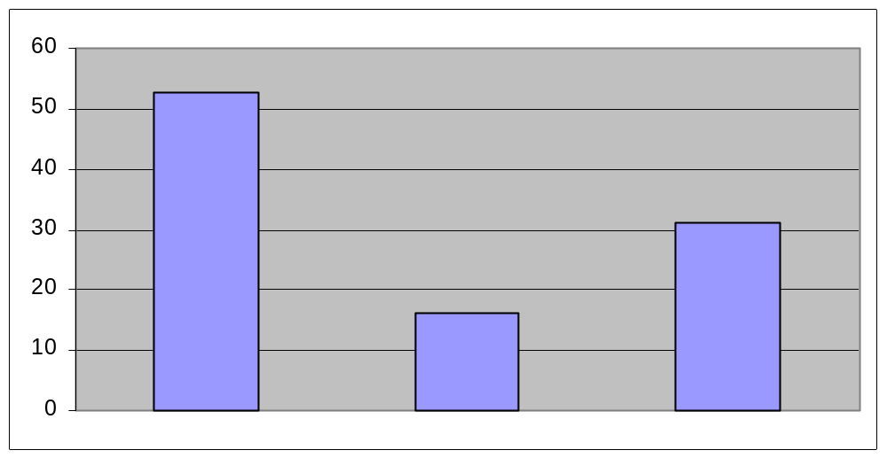
State of the practice
Cost overrun
Successful
Cancelled
The Standish Group, 2009
Successful projects (32%)
- Delivered fully functional on time and on budget.
Challenged (44%)
- Deliver less than full functionality, over-budget and late.
Failed (24%)
- Cancelled during development.

Slide 10
Software development problems
Software costs are increasing as hardware costs continue to decline.
Hardware costs vs. Software costs
Hardware technology has made
great advances.
Simple and well understood tasks
are encoded in hardware.
Least understood tasks are encoded
in software
Demands expected of software are
growing
Size of the software applications is
also increasing.
Hardware
costs
Software
costs
Time

Slide 11
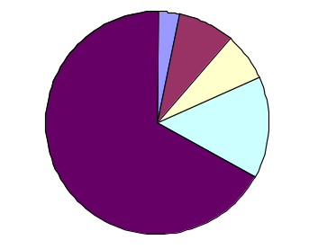
Software development problems (contd..)
Software development times are getting longer and longer and
maintenance costs are getting higher and higher
3%
8%
7%
Requirements -- 3%
Design -- 8%
Implementation -- 7%
Testing -- 15%
Maintenance -- 67%
15%
67%
Most of the money and effort spent in testing and maintenance.
85% of errors are introduced during requirements analysis and design.

Slide 12
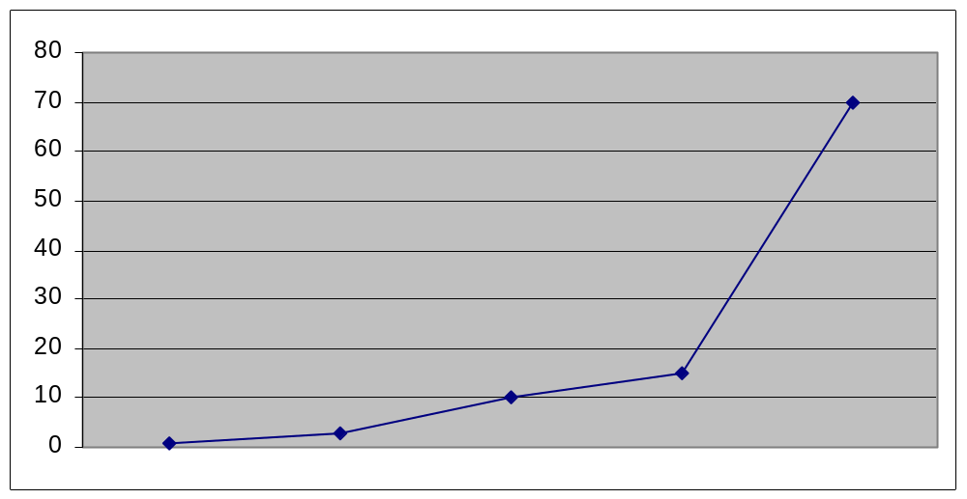
Relative costs to fix errors
Cost to fix an error increases as it is found later and later in
the software lifecycle. Why?
Cost
Design
Testing
Requirements
Implementation
Maintenance

Slide 13
Software development problems (contd..)
Software errors are getting more and more frequent as hardware
errors become almost non-existent.
Denver Automatic Baggage Handling System:
- Opening delayed for 2 years.
- $27 million cost overrun.
- $360 million delay cost.
Outages of AT&T long distance switches:
- Network unusable for about 9 hours on Jan 15, 1990
- First major network problem in AT&T’s network in 114 years.
Ariane 5 launch explosion, 4 June 1996:
- http://www.esrin.esa.it/htdocs/tidc/Press/Press96/ariane5rep.html
NIST estimates that the US economy loses approximately
$59.5 billion of 0.6% of the GDP due to software failures

Slide 14
Why are software projects late?
Estimating techniques are poorly developed
Estimates are based on optimism:
- Programmers are optimistic.
- Assume “All will go well” with the project.
- Don’t plan for slippage.
- “This is the last bug”.
- “It’s going to work this time”.
Optimism could be because of the nature of creativity:
- Conception of an idea and its implementation.
- Medium of creation constrains our ideas.
- In case of software the medium is infinitely malleable.
- Expect a few problems in implementation.
Our techniques of estimating are poorly developed. More seriously
they reflect an unvoiced assumption which is quite untrue, that is,
that all will go well.
-- Fred Brooks, The Mythical Man-Month

Slide 15
Why are software projects late? (contd..)
Estimating techniques confuse effort with progress.
Is one man working six months equal to six men working one month?
Cost does vary as the product of the number of people and the
number of months.
Progress does not!
Unit of man-month implies that men and month are interchangeable.
- True only when a task can be partitioned among many workers
with no communication between them.
- For sequential tasks, more effort has no effect on the schedule.
- Many tasks in software engineering have sequential constraints.
Our estimating techniques fallaciously confuse effort with progress,
hiding the assumption that men and months are interchangeable.
- Fred Brooks, The Mythical Man-Month

Slide 16
Why are software projects late ? (contd..)
Do not plan schedule effectively.
Few projects allowed for 50% of the projected schedule for
testing.
Most actually spent 50% of their time in testing.
In examining conventionally scheduled projects, I have found that few
allowed one-half of the projected schedule for testing, but that most
did indeed spend half of the actual schedule for that purpose. Many of
the projects were on schedule until and except in system testing…..
- Fred Brooks, The Mythical Man-Month.

Slide 17
Why are software projects late? (contd..)
Do not monitor progress effectively
Schedule slips day-by-day.
Day-by-day is harder to recognize, harder to prevent and harder
to make up.
How does a software project get to be a year late?..
One day at a time!
Fred Brooks, The Mythical Man-Month.

Slide 18
Why are software projects late ? (contd..)
When slippage is recognized, we add people.
Most tasks require communication among workers.
Communication consists of:
- Training.
- Sharing information (intercommunication).
Training affects effort at worst linearly, with the number of people.
For n workers, intercommunication adds n(n-1)/2 to effort.
- If each worker must communicate with every other worker.
Adding more people to an already late project is usually like “Adding
gasoline to fire!”
Adding manpower to a late software project makes it later.
Fred Brooks, The Mythical Man-Month.

Slide 19
Fred Brooks & The Mythical Man-Month
Fred Brooks became manager for IBM’s OS 360 in 1964.
  Previous experience in hardware design.
OS/360 (probably) largest software system attempted at that time.
  1000 people, 5000 man years.
OS/360 results:
  Late
  Took more memory than was planned.
  Costed several times the estimate.
  Did not perform very well until several releases after the first.
The Mythical Man-Month analyzes OS/360 experiences.
Professor at UNC Chapel Hill.
Experiences and analyses are true even today.

Slide 20
Definition of software engineering
IEEE definition:
  The application of a systematic, disciplined, quantifiable approach to the development, operation and maintenance of software; that is, the application of engineering to software.
Roger S. Pressman’s definition:
  Software engineering is the technology that encompasses a process, a set of methods and an array of tools.
(Software Engineering: A Practitioner’s Approach)
Parnas’s definition:
  Multi-person construction of multi-version software (Parnas 1978)

Slide 21
We have a “Software Crisis”! (1968)
“Software Engineering” was coined in 1968.
  NATO conference in Germany.
An “early study” of problem DOD projects revealed the following facts:
  47% of the software delivered could not be used.
    Usually did not meet the requirements.
  29% of the funded software not delivered.
    Usually not delivered due to cost/schedule overruns.
  19% of the software delivered after extensive rework.
    Costs a lot more to fix problems after release.

Slide 22
Historical perspective of software engineering
“Early days”
  1950’s programmers wrote programs
  Early 1960’s – very large software projects constructed by “experts”
  Mid-Late 1960’s – advent of large commercial software applications
    Large systems involved teams of software individuals
    Coining the term “software engineering”
Towards a software engineering discipline:
  Individuals could not see the “big picture”
  Increase in communication time
  Personnel changes impact on productivity

Slide 23
What software engineering is and is not..
Software engineering is concerned with “engineering” software systems, that is, building and modifying practical software systems:
  On time,
  Within budget,
  Meeting quality and performance standards,
  Deliver the features desired/expected by the customer.
Software engineering is not..
  Just building small or new systems.
  Hacking or debugging until it works.
  Easy, simple, boring or even pointless!
Issues that haven’t really surfaced in learning to program.
SE has progressed rapidly compared to other engineering disciplines

Slide 24
What software engineering is and is not.. (contd..)
Software engineering is concerned with building software systems with the following characteristics:
  Large and complex
  Built by teams
  Exist in many versions
  Last many years
  Undergo changes

Slide 25
Why software engineering
Program complexity transcends individual or lone programmer
Software engineering targeted for:
  Constructing large software applications
  Defining problem clearly and completely
  Tools and techniques to support process
  Team-oriented experience

Slide 26
Program to a software product transformation
3X
Program
Program
product
Checking
Account
Program
3X
9X
Programming
system
Programming
system product

Slide 27
Program to a software product transformation

Slide 28
Programmer vs. software engineer
Students familiar with programs and some forms of documentation through course projects in an academic environment:
  Size suitable for a single programmer.
  Get the computer to do something efficiently
  Working part-time over a short period.
  Based on the knowledge acquired in present or prior courses.
  Responsible only to the person who assigned the problem.
Experiences of professionals in the software industry:
  Sections of much larger systems.
  Written by many professionals over periods of years.
  Requiring knowledge in many fields of computer science and the application domain.
  Rarely work in isolation.
  Responsible for multiple -- bosses, clients, users, and subsequent generations of professionals.

Slide 29
Programmer vs. software engineer (contd..)
Programmer
  Individual with good skills
  Knowledge on data structures, algorithms
  Fluent in several programming languages
  May lack formal training
  Minimal exposure to CS
Programming-in-the-small

Slide 30
Programmer vs. software engineer (contd..)
Programming skill is not enough
Software engineering involves “programming-in-the-large”
  Understand requirements and write specifications
    Derive models and reason about them
  Master software
  Operate at various levels of abstraction
  Member of a team:
    Communication skills
    Management skills
CS provides the theoretical foundation for SE:
  Other disciplines are economics, management, and psychology
SE is concerned with producing things that are:
  Of practical, economic value
  Responsibility for correctness, suitability and safety

Slide 31
Programmer vs. software engineer (contd..)
Programming skill is not enough
Software engineering involves “programming-in-the-large”
  Understand requirements and write specifications
    Derive models and reason about them
  Master software
  Operate at various levels of abstraction
  Member of a team:
    Communication skills
    Management skills

Slide 32
What is a software product?
Software is:
- Instructions (computer programs) that when executed provide the
desired function and performance,
- Data structures that enable the programs to adequately manipulate
information, and
- Documents that describe the operation and use of programs.
Definition offered by R. S. Pressman.
(Software Engineering: A Practitioner’s Approach)
Alternatively,
Software is the definition and organization of a set of tasks and
functionality encapsulated into a form that is executable on a computer

Slide 33
Different types of software products
Commercial-off-the-shelf (COTS)
Legacy: Written in an “old” programming language
  Cobol, PL/1, Fortran, etc.
  C and C++!
Customized software products
  Systems that are commissioned by a specific customer and developed specially by some contractor
Client vs. server software
Database management systems/applications

Slide 34
Relating software engineering to computer science disciplines
Engineering disciplines:
  Rely on the underlying science to provide fundamental techniques and tools.
  Are concerned with not just what can be done, but with the processes by which it can be done most effectively.
  Address issues involved in “scaling-up” scientific techniques to industrial strength.
Software engineering builds on the fundamentals of Computer Science including:
  Programming languages
  Data structures
  Automata theory
  Algorithm analysis
  Discrete mathematics.

Slide 35
Software engineering and programming languages
Influence of software engineering on programming languages:
  Modularity for independent compilation
  Separation of design and implementation
  Migrating software engineering concepts into programming languages
    Classes in C++ (implementation of ADTs)
    Packages in Java/Ada95 (Modularization)
Influence of programming languages on software engineering:
  Precise description of requirements and design
  Compiler tools that enhance design and development
  Advanced compilers and libraries to improve productivity and facilitate reuse

Slide 36
Software engineering and operating systems
Influence of software engineering on operating systems:
  Relationship between components and versions
  Protected/non-protected portions of OS
  Vehicle through which programs developed
Influence of operating systems on software engineering:
  Virtual machines – evolving to platform independence with Java
  Levels of abstraction offered by OS
    Device driver through GUI of OS
    Java offers strong OS interactions
  Separation of design and implementation

Slide 37
Software engineering and databases/security
Influence of software engineering on databases/security
  Most applications contain database and requires access control
    Storage of large, unstructured objects
    Incorporation of multi-media and web-based data
    Versioning and long-term transactions
    Tracking who can use/see what when
Influence of databases/security on software engineering
  Promoting data independence
  De-coupling data definition from usage
  Databases as expected components in applications
  Security in applications and across networks

Slide 38
Software engineering and artificial intelligence
Influence of artificial intelligence on software engineering
  Exploratory development and scenarios
  Natural language and voice interfaces
Influence of software engineering on artificial intelligence:
  Construction of expert system shells
Notes:
.

Slide 39
Software engineering and theoretical models
Influence of theoretical models on software engineering
  Finite state machines for program behavior
  Queuing and simulation models
  Petri nets for resource behavior
  Regular and context free grammars for programming languages/compilers
Influence of software engineering on theoretical models
  Abstract data types
  Algebraic specifications
  Non-first order theories of logic or temporal logic

Slide 40
Software engineering and other disciplines
Software engineering on management:
  Management/team models applied to software project management/process control
  Important test domain to test new models and theories for management
Software engineering and electrical, chemical, civil engineering:
  Job growth in engineering specific software
Software engineering and biology, chemistry, medicine etc.
  Medical research and informatics, genome
Software engineering and financial sector:
  Banking, ATM networks, e-commerce, trading, stock and brokerage houses, etc.

Slide 41
Software Engineering is young..
Traditional engineering disciplines have been in existence for hundreds, if not thousands, of years.
Software engineering still needs:
  Standard specification and design techniques.
  Formal analysis tools.
  Established processes.
Currently experimenting in:
  Techniques, notations, metrics, processes, architecture, etc.
  Some success stories have been reported.
  A foundation is slowly emerging..

Slide 42
Role of software engineering in system design
Software engineering is a part of larger projects
Embedded
  Software requirements to be balanced against others
    For example, telephone switching systems. Certain requirements can only be met by hardware, software and special devices
Part of the complexity of software applications is because they have to interface with other components of the system

Slide 43
Software Engineering: Three key elements
Process
  Life cycle model used, project management and assessment, quality assurance, etc.
Methods:
  Approaches for solving a particular problem.
  The “how-tos” for doing some specific task.
  Examples: Object-oriented design, black-box testing, prototypes for requirements analysis.
Tools:
  Software that supports methods and/or processes.
  CASE: Computer-aided software engineering.
  Test environments, 4GLs, Design tools, etc.

Slide 44
Example: Process, Method, and Tools
Testing of individual code modules (before integration).
Process addresses issues such as how it is to be done, who is responsible for it, when does it get done, etc.
  Documents
    Overall Quality Assurance (QA) plan.
    Software test plan for each module based on factors such as design and test strategies, including test cases.
  Who has the responsibility?
    Independent testers or developers themselves?
    Independent department or a QA group within the organization.
  How do we verify (check) that it has been done?

Slide 45
Example: Process, Method, Tools
Method addresses issues such as what approach will be used?
  Example: Black-box testing:
    Determine representative usage of the module, or its “operational profile”.
    Design and generate test cases based on the representative usage information.
    Document the expected outcome of the test cases before testing commences.
    Check if the test cases produce expected behavior.
  Example: White-box or “coverage testing”:
    Examine the internal structure of the source code.
    Generate test cases to exercise the source code artifacts not yet exercised, or increase the percentage of the source code artifacts exercised by the test cases.
    Measure the “code coverage” afforded by the test cases.

Slide 46
Example: Process, Method, Tools
Tools provide software support for processes and methods:
  Test case generator:
    Creates test cases.
  Regression test environment:
    Repeats earlier test cases, to ensure that the original functionality provided by an application is intact after a change.
  Memory leak tool.
  Coverage testing and measurement tool.
  Problem reporting and tracking tool.
    Tracks the reporting and status of bugs.
  Test-case matrix.
    Mapping of test cases to requirements.

Slide 47
SE Best Practices
Proven through experience and research to reliably produce a desired result.
Considered to be prudent and advisable to do in a variety of contexts
“Etudes” in music:
  Short scores, solely written to improve technique
  Not pleasing to the ear
  Practice leads to beautiful music
Learn many best practices and practice them over and over.

Slide 48
Summary
Critical aspects of our day to day lives depend on software, yet software development lacks the rigor and discipline of mature engineering disciplines:
  Too many projects get delayed, costs and schedules slip.
Software engineering is about bringing discipline and rigor to the building and maintenance of software systems.
Study of software engineering focuses on three key elements: process, methods and tools.
In addition to the functionality/feature related requirements, software products are often expected to satisfy various non functional requirements:
  Relative priorities of these requirements depend on the nature of the application.
  May or may not be able to satisfy all the requirements, tradeoffs may be necessary.

